Slide 1
Substance use, abuse & Addiction

Slide 2
Goals of this Module
Develop a basic understanding of substances and how they can be used and/or abused
Learn about therapeutic options for addiction, including harm reduction approaches
Understand the impact of substance use on mental health and vice versa
Understand how to support patients in various stages, who are experiencing addiction or want to make a change in their behaviours

Slide 3
Agenda
Definitions
“Addiction” Diagnostic Criteria
Addiction and Mental Health
Substances
Stimulants
Depressants
Hallucinogens
Other Substances to Consider
Emergency Situations
Therapeutic Approaches
Resources
References

Slide 4
definitions

Slide 5
Substance Use (SU):
The use of any kind of substances (prescription, over-the-counter (OTC) preparations, alcohol, illegal drugs, steroids, inhalants) that alters mood, thinking and/or behaviour
Some substances have therapeutic value
Substance Abuse:
The repeated use of drugs/alcohol leading to functional problems
Problems do not include compulsive use or withdrawal
(APA, 2013)

Slide 6
Tolerance:
Develops with the continuous use of some drugs
Body becomes less responsive to the drug with repeated exposure & requires more to produce the same effect (e.g., cocaine, alcohol)
Withdrawal Reaction:
The reaction that occurs when a drug upon which the body has become physically dependent, is removed
Characteristics of withdrawal reaction vary with the drug used
(APA, 2013)

Slide 7
“Addiction” DSM - 5

Slide 8
10 Most Important Things to know about Addiction
Please read the article.
http://www.ama.lu/docs/addiction105_sellmann.pdf
(Sellman, 2009)

Slide 9
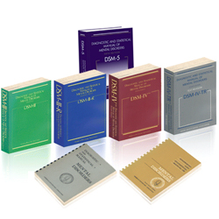
Who Defines “Addiction”
“Addiction” is not considered a specific diagnosis in the fifth edition of The Diagnostic and Statistical Manual of Mental Disorders (DSM-5)
The DSM-5 contains an “addictions and related disorders” category
Substance-related disorders are classified in two groups:
Substance use disorders
Substance-induced disorders
(APA, 2013)

Slide 10
Substance Use Disorders
“Patterns of symptoms resulting from use of a substance which the individual continues to take, despite experiencing problems as a result.”
Substance use disorders span a wide variety of problems arising from substance use, and cover 11 different criteria:
Impaired control: (1) taking more or for longer than intended, (2) unsuccessful efforts to stop or cut down use, (3) spending a great deal of time obtaining, using, or recovering from use, (4) craving for substance.
Social impairment: (5) failure to fulfill major obligations due to use, (6) continued use despite problems caused or exacerbated by use, (7) important activities given up or reduced because of substance use.
Risky use: (8) recurrent use in hazardous situations, (9) continued use despite physical or psychological problems that are caused or exacerbated by substance use.
Pharmacologic dependence: (10) tolerance to effects of the substance, (11) withdrawal symptoms when not using or using less.
(APA, 2013)

Slide 11
The DSM 5 allows clinicians to specify how severe the substance use disorder is, depending on how many symptoms are identified:
2-3 = indicate a mild substance use disorder
4-5 = indicate a moderate substance use disorder
6+ = indicate a severe substance use disorder
Clinicians can also add “in early remission,” “in sustained remission,” “on maintenance therapy,” and “in a controlled environment”
(APA, 2013)

Slide 12
Substance Induced Disorders
Symptoms that can be caused directly by the drug during or immediately after individual episodes of use
Substance-induced disorders include:
1. Intoxication
2. Withdrawal
3. Substance induced mental disorders (including psychosis, depressive disorders, anxiety disorders, obsessive-compulsive, sleep disorders, sexual dysfunctions, delirium, etc.)
(APA, 2013)

Slide 13
DSM-4 vs DSM-5 Changes in Addiction
Gambling Disorder has now been added under “Addictions” in DSM-5
Substance Abuse Disorders do NOT separate “abuse” from “dependence”, as it did in DSM-4
Criterion for craving and strong urge has been added
Criterion for legal problems has been removed in DSM-5
Threshold is at 2 or more criteria instead of 1 or more
Cannabis withdrawal and caffeine withdrawal are new disorders
Severity in DSM-5 SUD is based on number of criteria:
DSM-4 specifier for physiological subtype and polysubstance dependence is eliminated
Early remission in DSM-5 is defined as at least 3 but less than 12 months without meeting substance use disorder criteria (except craving) and sustained remission is defined as at least 12 months without meeting criteria (except craving)
New specifiers include: “in a controlled environment” and “on maintenance therapy” as the situation warrants
(APA, 2013)

Slide 14
NEW to DSM-5: Gambling Disorder
Persistent and recurrent problematic gambling behaviour leading to clinically significant impairment or distress, as indicated by the individual exhibiting four (or more) of the following in a 12-month period:
Needs to gamble with increasing amounts of money in order to achieve the desired excitement.
Is restless or irritable when attempting to cut down or stop gambling.
Has made repeated unsuccessful efforts to control, cut back, or stop gambling.
Is often preoccupied with gambling (e.g., having persistent thoughts of reliving past gambling experiences, handicapping or planning the next venture, thinking of ways to get money with which to gamble).
Often gambles when feeling distressed (e.g., helpless, guilty, anxious, depressed).
After losing money gambling, often returns another day to get even (“chasing” one’s losses).
Lies to conceal the extent of involvement with gambling.
Has jeopardized or lost a significant relationship, job, or educational or career opportunity because of gambling.
Relies on others to provide money to relieve desperate financial situations caused by gambling.
(APA, 2013)

Slide 15
What Causes Addiction?
Click Here to watch video on What Causes Addiction? (5:40mins)
Client’s Story
Click here to watch a video on a Client’s Story (5:30mins)

Slide 16
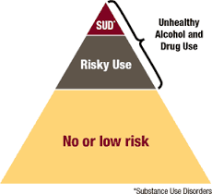
Continuum of Substance Use *SUD= Substance Use Disorder

Slide 17
Continuum of Substance Use
Type | Description
Non-use | Do not use alcohol or drugs
Experimental use | Person tries drug out drug to curiosity. May or may not try drug again
Social/Recreational Use | Person seeks out the substance to enhance a social occasion. Use is irregular, infrequent, and usually occurs with others (e.g., a drink on a social occasion).
Situational use | There is definite pattern of use, and person associates use with a particular situation. There is some loss of control but not yet experiencing negative consequences
Intensive use | AKA bingeing – substance is used in an intense manner consuming large amounts over short period of time, or engaging in continuous use over a period of time
Dependence | Person is psychologically and/or physically dependent on a drug, which is used excessively and the use continues despite the person experiencing serious problems. Degrees of dependence range from mild to compulsive, with the latter being characterized as addiction
(Abadinsky, 2008)

Slide 18
Addiction & Mental health

Slide 19
Concurrent Disorders (CD)
mental health disorder(s)
+ substance use disorder(s)
= concurrent disorder

Slide 20
Why It’s Important to Treat
People living with Concurrent Disorders are at higher risk for:
Suicide
Homelessness
Victimization
Incarceration
Hospitalization
HIV/HCV infection
Family violence

Slide 21
Intro to Concurrent Disorders
Please watch the following videos:
https://www.youtube.com/watch?v=n2DYngb7zEI (5:30mins)
https://www.youtube.com/watch?v=5SGWGcSOjoc (3:40mins)

Slide 22
Prevalence of CD in…
Anxiety Disorders | 24%
Major Depression | 27%
Schizophrenia | 47%
Bipolar Disorder | 56%
Gambling Disorder | 52%*
(Skinner, O'Grady, Bartha & Parker, 2004), (Maccallum, 2002)*

Slide 23
Demographic Correlates
Gender
Men more likely to develop alcohol/drug use disorders
Age
Younger people more likely to abuse substances (especially cocaine & cannabis)
SU often begins at early age & may precede or precipitate onset of MI
Education
Often have lower levels of educational attainment than other people with SMI
Marital Status
People with SMI who have never married more likely to develop drug abuse/dependence problems
Race & Geographic location
Rates more likely to reflect market availability of substance
Mueser, 2004

Slide 24
Using Substances to Self Medicate
Positive symptoms:
Alcohol, cannabis used to sedate, numb, attempt to suppress auditory hallucinations
Negative (or dysphoric) symptoms:
Nicotine, alcohol, cannabis, cocaine used to try to increase mood
Cognitive symptoms:
Nicotine, alcohol, cannabis, cocaine commonly used to try to increase focus/attention
Extrapyramidal symptoms (EPS):
Nicotine, alcohol, cannabis, cocaine commonly used to decrease Parkinson-like side effects
EPS are drug-induced movement disorders

Slide 25
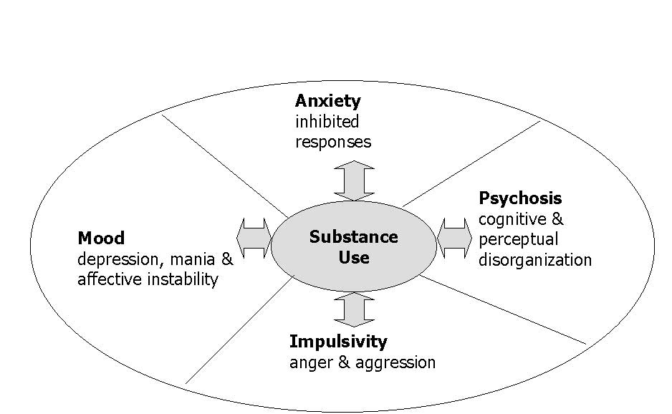
Relationship Between Addictions & Mental Health
(Skinner, W. 2004)

Slide 26
Relationship Between Addictions & Mental Health Con’t
SU & MH may be triggered by the same factor
A factor genetic, developmental, environmental or other can cause both a substance use or mental health problem
MH may influence a SU problem
Severe MH, such as schizophrenia and bipolar disorder, may cause these people to use substances in order to cope with their mental health
SU may influence a MH problem
Substances can induce psychiatric symptoms which in return can lead to a development of a MH problem
SU and MH problems may not interact
Even when one problem area is addressed the other problem area is still active
Some people controlling their substance use will produce immediate positive changes in their MH but for others it might mean that their MH symptoms would be more active
(CAMH, n.d.)

Slide 27
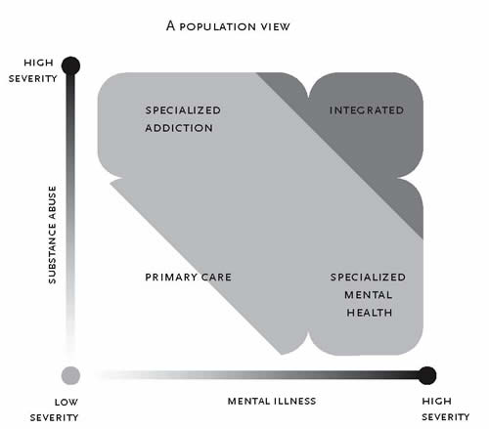
Concurrent Disorders: High Mental Health & High Substance Use
(CAMH, n.d.)

Slide 28
Substances

Slide 29
What makes substances addictive?
Substance → elicits overreaction in reward system pathways in the brain and either a dramatic increase or decrease in neurotransmitters (like dopamine, serotonin etc.) that causes a pleasurable and ultimately addictive feelings
The following are factors of the substance affects the brain chemistry:
Dosage
Duration of Use
Frequency of Use
Route of administration (e.g., inhalation, intravenous, nasal, oral)
Environment (Family members, peers, friends etc.)
Route of administration factors:
1) Time to onset
2) Peak
3) Duration
4) Half-life

Slide 30
Substances of Abuse
Three main categories:
Stimulants
Depressants
Hallucinogens
Categorized according to effect on Central Nervous System (CNS)

Slide 31
Stimulants
SUBSTANCES 1.0

Slide 32
Category: Stimulants
Ex. Caffeine, pseudoephedrine, Ritalin, cocaine, crack-cocaine, crystal meth
Impact on body:
Blood pressure, temperature, heart rate, Respiratory rate, alertness, dilated pupils, dry mouth
Feelings: Euphoria, invincible, energetic, sped up
(Abadinsky, 2008)

Slide 33
Category: Stimulants
Withdrawal:
Crash, craving, extinction
Risks:
Heart attack, stroke, irregular heart beat, seizure, agitation, paranoia, weight loss, substance induced psychosis, coma, death
Risk of long term illicit use:
Acquired infections (HIV, HEP C, abscess), profound psychiatric effects (delusions, hallucinations [esp. tactile], anxiety, severe depression, anhedonia), social risks, safety risks
New research:
Depression risk, med’s for spasm, brain damage, reward selection
(Abadinsky, 2008)

Slide 34
Stimulant: Caffeine
Reported to be the most commonly consumed psychoactive substance in the world
Coffee, chocolate, cola, tea, some over the counter medications, Red Bull
Body develops a tolerance & more is needed to achieve same effect
Tolerance determines withdrawal symptoms
Withdrawal symptoms: headache, loss of energy/alertness
(Abadinsky, 2008)

Slide 35
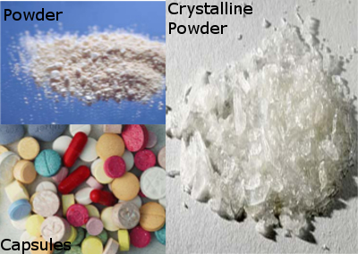
Stimulant: Crystal Methamphetamine
AKA: meth, ice, glass, crystal, speed, crank,
Smoked in glass pipes, snorted, swallowed, or injected (either dry or dissolved in water)
Highly addictive
Produces intense initial euphoria, increased energy, libido, alertness lasting approx. 6-12 hours (“tweaking”)
(Casacolumbiaorg, 2013)
(Abadinsky, 2008)

Slide 36
Stimulant: Crystal Methamphetamine
At low doses, methamphetamine produces such effects as:
Increased wakefulness
Increased physical activity
Increased heart rate, blood pressure, respiration and body temperature (hyperthermia)
Decreased appetite
Euphoria
High-dose chronic use has been associated with:
Irritability
Tremors, convulsions
Severe dental problems (aka. “Meth mouth”)
Anxiety, paranoia
Aggressive and violent behavior, often directed at spouses and children
Death, resulting from extreme anorexia, hyperthermia, convulsions, and cardiovascular collapse (including stroke and heart attacks)
(Abadinsky, 2008)

Slide 37
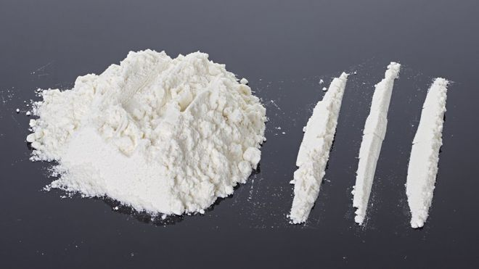
Stimulant: Cocaine Three Phases of Cocaine Usage
Initial Phase | Plateau Phase | Withdrawal Phase
Euphoric, energetic, self-confident Decreased appetite & need for sleep Heightened mental alertness Heightened sensitivity to sight, sound, & touch Increased heart rate & blood pressure Dilated pupils Increased temperature May show anxiety, paranoia & restlessness Constricted blood vessels | Physical experience of pleasure still present but not as intense Users will not at this point be having the intense cravings characteristic of withdrawal phase Mental alertness & focus still present Reduction in appetite & need for sleep still present Heart rate & blood pressure still elevated, pupils still dilated – but drug effects starts to wear off | Users describe craving more drug at this point Irritability Anhedonia Mood disturbances from low mood to more severe depressive symptoms Fatigue & need for sleep Restlessness may still be present A frequent pattern of cocaine/crack use is to go on a run or to use in a binge

Slide 38
Stimulant: Cocaine
Route | Onset | Peak Effect | Duration | Half-Life
Inhalation | 7 seconds | 1-5 minutes | 20 minutes | 40-60 minutes
Intravenous | 15 seconds | 3-5 minutes | 20-30 minutes | 40-60 minutes
Nasal | 3 minutes | 15 minutes | 45-90 minutes | 60-90 minutes
Oral | 10 minutes | 60 minutes | 60 minutes | 60-90 minutes
(Burnett, 2002)

Slide 39
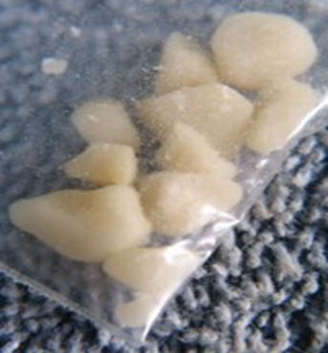
Stimulant: Crack Cocaine
A.K.A. “rock”, “grit”
A “free base” form of cocaine
Highly addictive
May be injected or smoked
The term “crack” refers to the crackling sound the rock makes when it is heated
Effects are felt immediately & disappear more quickly than cocaine
Video: ASAP Science "Your Brain on Crack-cocaine" (3min)
Crack is being sold at prices low enough that even adolescents can afford to buy it. Approximate costs in Hamilton range from $5 - $20 for one use.
(Abadinsky, 2008)

Slide 40
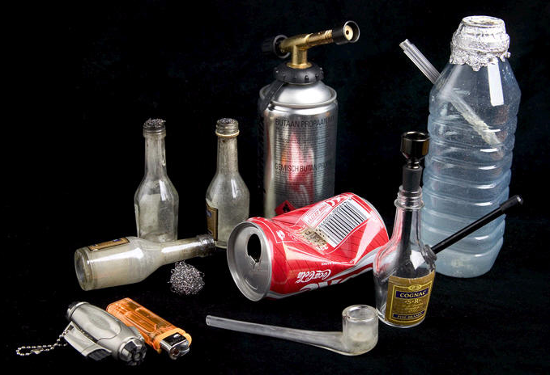
Paraphernalia
Stimulant: Crack Cocaine
Smoked through a
glass pipe or homemade pipe
Can also be injected by mixing the crack cocaine with vinegar or another form of acid…

Slide 41
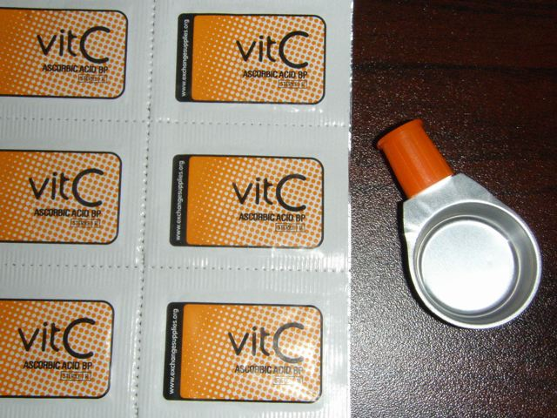
Harm Reduction
Stimulant: Crack Cocaine
Vitamin C (left) can be used to break down crack rather than vinegar
Disposable cooker (right) is for one time use, which is a principal for harm reduction supplies
Available in Hamilton from the Van Needle Exchange
Also view Ontario Harm Reduction Distribution Program items at http://www.ohrdp.ca

Slide 42
Stimulant: Cocaine/Crack
Medical Complications
Cardiovascular – Disturbances in heart rhythm & heart attacks
Respiratory – Chest pain & respiratory failure
Neurological effects – Headaches, strokes, & seizures
Gastrointestinal – Abdominal pain and nausea, significant weight loss & malnourishment
Cognitive – Impaired memory
Mental – Habitual crack use can lead to psychosis, paranoia, hallucinations and formication (i.e., falsely believing that insects or bugs are crawling under your skin). These symptoms can lead to depression and suicidal behavior.
Perhaps the most dangerous aspect of crack usage is the high risk of overdose. Since crack is more potent than street cocaine, it enters the bloodstream more quickly and in higher concentrations. This is particularly risky since smoking the drug makes it difficult to estimate dosage.
(Burnett, 2002)

Slide 43
Stimulant: Cocaine/Crack
Withdrawal
Those who abruptly stop their cocaine/crack use can experience withdrawal symptoms as they readjust to functioning without the drug
The length of withdrawal varies from person to person & on the amount and frequency of use
Few physical symptoms but extreme craving and mood disturbances created by withdrawal can threaten a person’s desire to become sober
Regular use can lead to strong psychological dependence

Slide 44
depressants
SUBSTANCES 2.0

Slide 45
Category: Depressants
Ex. Over the counter cough/cold med’s, gravol, benzodiazepines, alcohol, opiates
Impact on body:
Blood pressure, temperature, heart rate, respiratory rate, alertness
Feelings: Sedated, euphoria, tranquil, calm
(Abadinsky, 2008)

Slide 46
Category: Depressants
Acute Risks:
Low respiratory rate, low blood pressure, low heart rate, loss of consciousness, depression, coma, death.
Withdrawal: Crash, craving, extinction.
**High variation in withdrawal risks and time lines in this category
(Abadinsky, 2008)

Slide 47
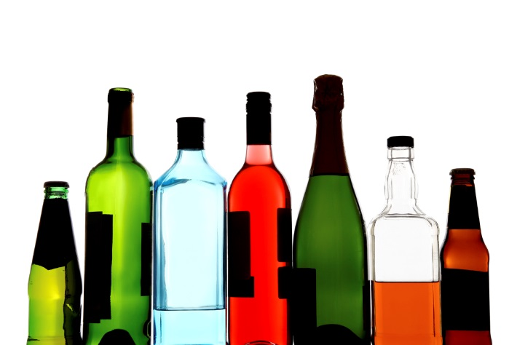
Depressants: Alcohol
Central Nervous System depressant
Produces relaxation & disinhibition at low doses
At higher doses, producing intoxication, impaired judgment & coordination
At even higher doses, coma and death are possible
Not only found in beer, wine & liquor, but also in some over the counter medications and products
Video: ASAP Science "Alcohol“ (2min)
(Butt, 2011)

Slide 48
Depressants: Alcohol
People who drink Alcohol on a regular basis become tolerant to many of the unpleasant consequences, and thus are able to drink more before suffering these effects
Yet even with increased consumption, many such drinkers don't appear intoxicated
Psychological addiction to alcohol may occur with regular use of even relatively moderate daily amounts
It may also occur in people who consume alcohol only under certain situations, such as before and during social occasions
This form of addiction refers to a craving for alcohol's psychological effects, although not necessarily in amounts that produce serious intoxication
For psychologically addicted drinkers, the lack of alcohol tends to make them anxious and, in some cases, panicky
(Butt, 2011)

Slide 49
Depressants: Alcohol What equals what?
12 oz of Beer
(5% alcohol)
5 oz of wine
(10-12% alcohol)
3 oz of fortified wine
(16-18% alcohol)
1.5 oz of Liquor
(40% alcohol)
Keep these guidelines in mind when interviewing clients about their regular alcohol intake. For example, if a client tells you that they are drinking 2-3 beers per week, it is important to clarify… “Is it 2-3 bottles, regular sized cans, tallboy cans?”
(Butt, 2011)

Slide 50
Canada’s “Low Risk Drinking” Guidelines
Depressants: Alcohol
Visit Canadian Centre for
Substance Abuse
for details and resources www.ccsa.ca
(Butt, 2011)

Slide 51
Depressants: Alcohol
Factors that influence the impact/risks of alcohol:
Amount & frequency
Age at which person began drinking & how long they have been drinking
Age, level of education, gender, genetic & family history
Prenatal alcohol exposure
General health status
Fragile brain
(Butt, 2011)

Slide 52
Depressants: Alcohol Withdrawal
The time course for alcohol withdrawal is variable and is influenced by a number of factors such as amount consumed, time of last drink, previous withdrawal events and current medical condition. However, it typically follows these stages:
(Butt, 2011)
6-24 hours after last drink
Tremors, sweating or rapid pulse
Tachycardia / hypertension
Insomnia
Nausea or vomiting
Physical agitation, anxiety
Rarely, alcohol may still be measurable in blood
24-36 hours
Visual, tactile or auditory hallucinations/illusions
Onset/duration is variable
3-5 days
Grand Mal seizures
Use the CIWA to guide care:
Mild Withdrawal (CIWA-Ar < 8)
Ongoing monitoring of s/s using CIWA
Monitor vital signs
Supportive care
Moderate withdrawal (CIWA-Ar 8-12)
More frequent monitoring using CIWA
Monitor vital signs
Consider benzodiazepine (monitor respiratory status)
Seizure/safety precautions
Severe Withdrawal (CIWA >12)
As above
Treat with benzodiazepines

Slide 53
Depressants: Alcohol Withdrawal
It is important to note that the risk of alcohol withdrawal may not be limited to those who are considered heavy drinkers and therefore staff should be alert for withdrawal symptoms in anybody who is regularly using alcohol in any amount.

Slide 54
Depressants: Alcohol Risks of Long Term Use
High blood pressure
Weak heart muscle
Liver damage: 3 stages
Dementia
Cerebellar disease [sy. Balance & gait]
Peripheral neuropathy [nerves in legs/feet]
Wernicke-Korsakoff syndrome
Low B1 [thiamine]
Wernicke: emergency, appear impaired
Korsakoff’s: no STM
(Butt, 2011)

Slide 55
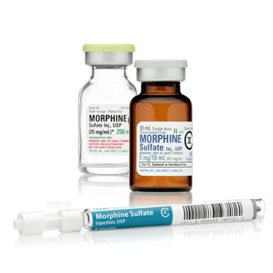
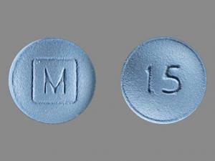
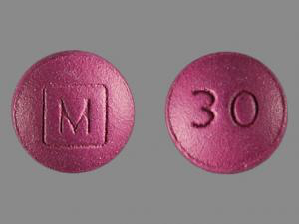
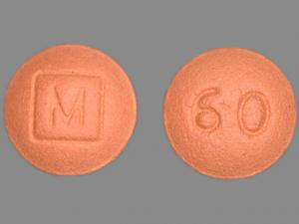
Depressants: Opioid Analgesics
Pain killing medications that may also produce an extreme sense of well-being
High risk of dependency, occurs rapidly
Some are natural (e.g. morphine, codeine)
Other are synthetic (e.g. OxyCodone)
When taken with other CNS depressants, the effects are intensified and death can occur, called “synergistic effect”
(Fischer, 2006)

Slide 56
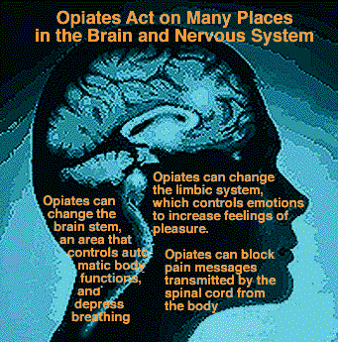

Slide 57
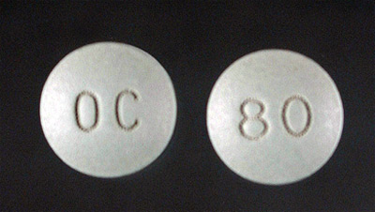
Depressants: OxyContin
OxyCodone (Percocet)
AKA “percs”
Contains acetaminophen, which makes you sick in large doses
OxyContin
AKA “Oxy”, “OC” – 10, 20, 40, 80, 160 mg tabs
Slow release properties overcome by crushing or chewing tablet releasing all of oxycodone at once
Can be chewed/swallowed, crushed/snorted or cooked/injected
No acetaminophen to make you sick if you take a lot
Video: The History of Oxycodone (2 min’s)
Longer Documentary: Fifth Estate, Time Bomb: The Oxycontin Story (42mins)
(Cicerno, 2005)

Slide 58
Depressants: OxyContin
Common signs that a person may be dependent:
High tolerance: Needing to take more and more in order to get the same or desired effect
Dependence: Feeling physical withdrawal symptoms if a dose is missed
Compulsive use: Craving the drug and doing whatever it takes to get it, even despite adverse social, psychological or physical consequences
Secretive or deceitful behavior in order to obtain the drug: Having multiple prescriptions from more than one doctor or buying it off the street
(Cicerno, 2005)

Slide 59
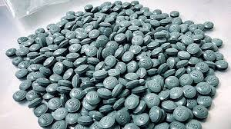
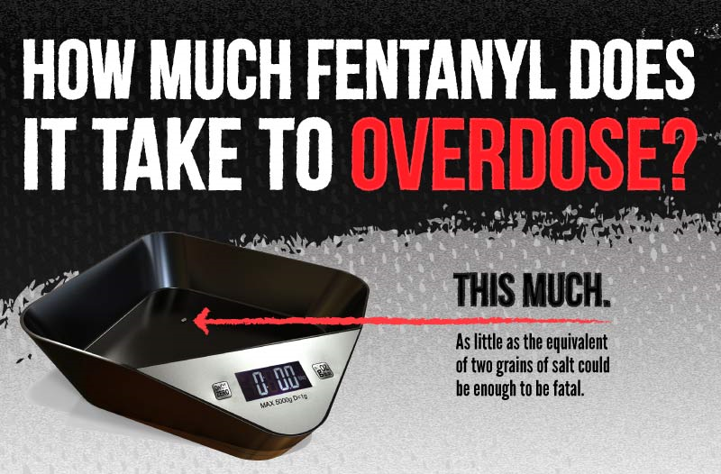
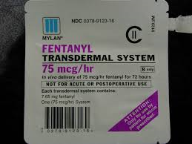
Depressants: Fentanyl
Fentanyl is often passed off as OxyContin
Fentanyl is about 100 times more toxic than morphine, heroin, or oxycodone
Forms: IV, transdermal, oral
Please Watch: Understanding Fentanyl (2:30mins)
(Firestone, 2009)

Slide 60
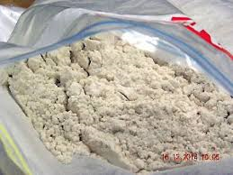
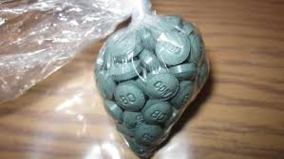
Depressants: “W-18”
​​​​Man-made opioid
Not used for medical reasons
W-18 is much stronger than other opioids
W-18 and other W-series opioids are 1½ to 1000 times more toxic than fentanyl
Not regulated in Canada under the Controlled Drug and Substances Act, which means it can be made and sold freely
(Fischer, 2006)

Slide 61
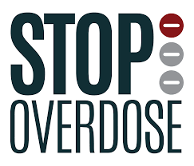
Depressants: Opioids Signs of Abuse
Small, pinpoint pupils
Clammy, cold skin
Fatigue or weakness
Lack of coordination when intoxicated
Nausea and vomiting
Nodding in and out of consciousness
Detachment, bewilderment, confusion
Slow and shallow breathing
Decreased heart rate
(Fischer, 2006)

Slide 62
Depressants: Opioids
Withdrawal Symptoms
Can be similar in intensity to withdrawal from heroin
Can begin within 6 hours of last dose and last up to a week
Symptoms include: shakes, cramps, diarrhea, vomiting, muscle pain, trouble sleeping & agitation
Use COWS (clinical Opioid Withdrawal Scale)
Overdose Symptoms
Signs/symptoms include difficult or slow breathing & extreme sleepiness (call 911 immediately if suspected)
Risk increases if you take OxyContin with other opioids, alcohol or tranquillizers
Overdose can lead to brain damage or death
NARCAN – Now available in the community!
(Fischer, 2006)

Slide 63
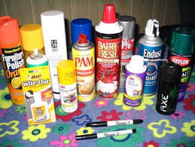
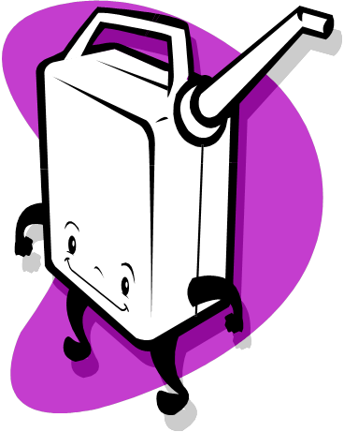
Depressants: Inhalants
Can include cleaning products, glues, paint thinner, gasoline, nitrous oxide, lighter fluid
Sniffed/inhaled
Produce feelings of euphoria, lightheadedness, exhilaration, & vivid fantasies
Slow down body functions, especially breathing
Use can cause brain damage, asphyxiation & death
(Abadinsky, 2008)

Slide 64
Depressants: Benzodiazepines
AKA “downers”, “V”, “benzos”
Commonly prescribed for management of anxiety, sleep problems, as muscle relaxants, control of seizures & to reduce symptoms associated with alcohol withdrawal
Produce a sense of calm and well-being at low doses
At very high doses can result in coma
Abrupt withdrawal causes seizure risk
Overdose is unlikely from benzodiazepines on their own, but there is high risk when mixed with alcohol or antihistamines
(Casacolumbiaorg, 2013)

Slide 65
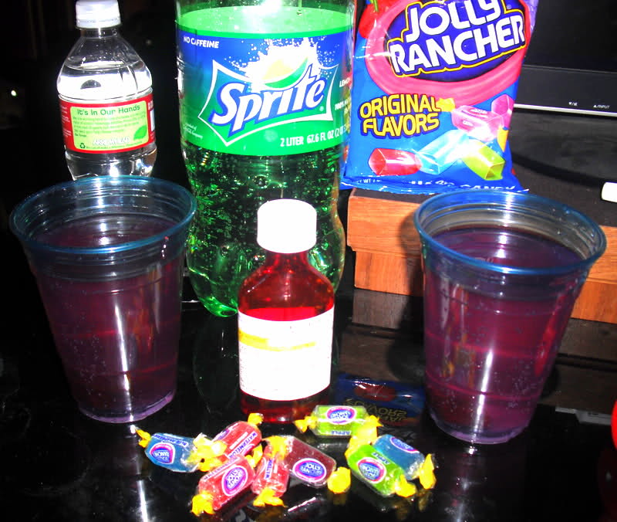
Depressants: Cough Syrup (DXM)
Dextromethorphan (DXM) is found in over the counter cough syrup (cough suppressant)
“Drank” is popular in hip hop and teen culture – This is cough syrup is mixed with Sprite and Jolly Ranchers (a.k.a. “sizzurp”, “purple drank”, “lean”)
Lil Wayne Hospitalized
(Abadinsky, 2008)

Slide 66
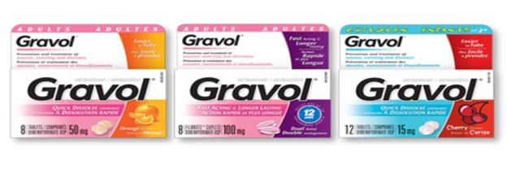
Depressants: Gravol
Over the counter
Cause hallucinations (visual and auditory), excitement, disorientation, slurred speech, euphoria, confusion/violent behaviour at larger doses
Taking with alcohol, codeine or other depressant drugs intensifies these effects
(Addiction & Mental Health, Alberta Health Services, 2015)

Slide 67
hallucinogens
SUBSTANCES 3.0

Slide 68
Category: Hallucinogens
Ex. Cannabis, LSD, psilocybin, salvia, PCP, MDMA, ketamine, mescaline, peyote
Sometimes called “psychedelic drugs”
Drugs that dramatically alter perception, emotions & mental processes
Distort senses & can cause hallucinations
Feeling during a “trip” can vary from hallucinations, relaxation, or paranoia
(Abadinsky, 2008)

Slide 69
Category: Hallucinogens
Risks of Use:
Lung damage [smoking, inhalation]
Psychotic reactions
Racing heart beat
“Flash backs”
Risk of injury
Video: ASAP Science "Your Brain on 'Shrooms“ (3min)
(Abadinsky, 2008)

Slide 70
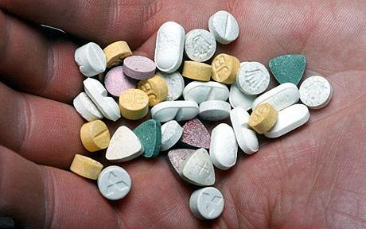
Hallucinogens: MDMA
AKA – “Ecstasy”, “E”, “XTC”, “X”, “Molly”
Referred to as a club drug
Is a synthetic drug
Sometimes has other drugs added to it (caffeine, PCP, amphetamines, dextromethorphan (found in some cough syrups), and cocaine), so the purity is very questionable
Effects are similar to hallucinogens + stimulants
Can be addictive
Video: ASAP Science "Your Brain on MDMA“ (2min)
(Abadinsky, 2008)

Slide 71
Hallucinogens: MDMA
Effect is about 3-6 hours
Takes only about 15 minutes to enter the bloodstream once ingested and the peak effect is at 45 minutes
Users feel alert/hyper initially
Some experience agitation & anxiety
Enhanced sense of touch
Sweating / chills may occur
Can cause muscle tension, nausea, blurred vision, increased heart rate & blood pressure
Grinding of teeth is common
Effects from even one pill can include depression
(Abadinsky, 2008)

Slide 72
Hallucinogens: MDMA
Dangers:
Can cause hyperthermia, seizures, cardiac arrhythmia, or death
It is unknown if causes any long term brain damage
Often used in combination with other drugs, including alcohol, which may further increase risks
Harm Reduction:
Drink water to avoid dehydration
(Abadinsky, 2008)

Slide 73
Hallucinogens: MDMA
Even after only one pill, withdrawal effects can include:
Fatigue
Loss of appetite
Depressed feelings
Anxiety
Memory loss
Trouble concentrating
Can last for several days to a week or longer in regular MDMA users
(Abadinsky, 2008)

Slide 74
Hallucinogens: Cannabis
Cannabis includes:
Marijuana (flowering tops of plant/leaves) (A.K.A. Weed, Grass, Pot, Mary Jane, Ganga)
Hash (dried, black-drown, resinous exudate from leaves)
Hash Oil (can be prepared and smoked or injected)
Derived from Indian hemp plant
Most commonly used illicit drug (currently in Canada)
All parts of plant contain psychoactive cannabinoids – THC is most abundant
It is basically a hallucinogen but also produces depression & tachycardia
The potency has increased in recent years due to agricultural and cultivation techniques
Watch ASAP Science video: Your Brain on Marijuana
(Abadinsky, 2008)

Slide 75
Hallucinogens: Cannabis
Short Term Effects
Increased hunger (“munchies”)
Impaired short-term memory
Impaired reaction time, coordination and motor skills
Dry mouth and throat
Irritation of the respiratory tract (with smoking)
Red eyes
Can cause spontaneous laughter
May cause mild paranoia, anxiety or panic
Drowsiness
Increased heart rate and decrease in blood pressure
Regular Use
Impaired motivation & concentration can impact school and work performance
Long Term Effects
Bronchitis
Cancer (same toxic substances as found in tobacco smoke)
Other Effects
Can precipitate psychosis or schizophrenia
Can complicate course & treatment of mental illness
(Abadinsky, 2008)

Slide 76
Hallucinogens: Cannabis
Withdrawal:
Nausea lasting 1-2 days
Tremor
Anxiety
Sleeping difficulty
Emotional volatility
Assess physical vs. psychological symptoms
(Abadinsky, 2008)

Slide 77
Hallucinogens: Cannabis
There is evidence that THC and other cannabis constituents are helpful in relieving symptoms associated with some medical conditions (e.g., nausea/vomiting, MS, glaucoma, epilepsy, etc.)
THS has also been synthetically developed and marketed as Marinol and Cesamet (nabilone) which can be used to treat nausea/vomiting resulting form chemotherapy. The treatment of AIDS related anorexia is also an approved use of Marinol.

Slide 78
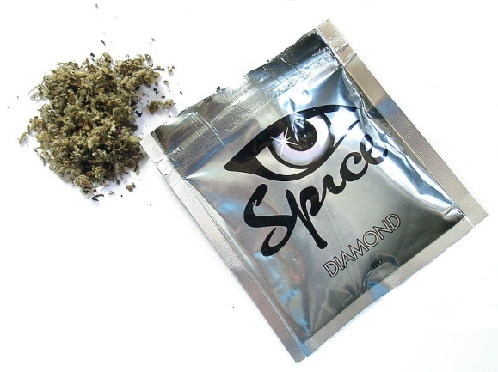
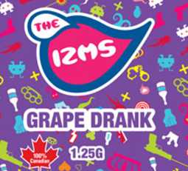
Synthetic THC
A.K.A. Spice, IZMS, K2, Mojo, Aroma, Dream, Chill, Chaos
“Although herbal incense products are labeled “not for human consumption,” they are sold by “head shops” and on the Internet without age restrictions and typically are purchased for the sole purpose of ingesting them, usually by smoking.” - Pierre, 2011
Case reports have linked use of herbal incense products containing synthetic cannabinoids to psychosis

Slide 79
Other substances to Consider
SUBSTANCES 4.0

Slide 80
Other Substances to Consider
Salvia
A perennial herb which belongs to the mint family
Most potent naturally occurring hallucinogen
Causes intense, short-lived hallucinogenic effects
Simple possession is not prohibited under the CDSA: http://www.hc-sc.gc.ca/hc-ps/substancontrol/substan/legal-salvia-statut-eng.php
(Abadinsky, 2008)

Slide 81
Other Substances to Consider
Nutmeg
Seeds of nutmeg can be abused because of psychotropic effects described after ingestion of large doses (≈ 2 grams)

Slide 82
Other Substances to Consider
Bath Salts (synthetic cathinone)
A kind of synthetic drug with mood-altering and stimulant properties, typically in the form of crystals and containing MDPV or mephedrone
Can cause violence in some cases (Baumann, 2014)
Synthetic cathinone products marketed as "bath salts" should not be confused with products such as Epsom salts that people use during bathing, which have no mind-altering ingredients.
(DrugAbuse, 2016)

Slide 83
Emergency situations

Slide 84
Stages of Withdrawal
Acute:
People will often experience physical symptoms of withdrawal in the first stage, although this will depend on the drug & the individual
May last a few weeks maximum
Post-Acute Withdrawal (PAWS):
Fewer physical symptoms (if any at all), but more emotional and psychological symptoms
Mood swings, low enthusiasm, anxiety, irritability
Fatigue, variable energy, disturbed sleep
Variable concentration
Cognitive impairment
Memory problems
Unable to recognize internal cues (esp. stress)
Periodic episodes (no obvious trigger) for about 2 years

Slide 85
Coping with Withdrawal
Have a plan
Understand that this is not abnormal
Have a support system
Avoid high risk situations
Theses symptoms can feel so bad that they can trigger a relapse for a person in recovery. It’s important that such individuals know about the symptoms of withdrawal so that they are prepared and know that the symptoms are time limited.

Slide 86
Emergency Situations of Drug Use
Acute Intoxication from depressants & opioids/narcotics
Acute Intoxication from stimulants
Acute Intoxication from hallucinogens
Withdrawal from depressants
A combination of any of the above
TWO DECISIONS TO MAKE:
INTOXICATION OR WHICH DRUG IS HAVING
WITHDRAWAL THE PREDOMINANT EFFECT
1
2

Slide 87
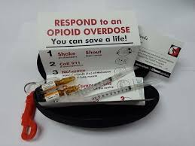
1. Acute Intoxication from Depressants, Narcotics
Emergencies associated with intoxication of these drugs all depress the central nervous system:
Depressed Consciousness - Hard to rouse them, can be serious condition
Aspiration - Can result in severe pneumonia and/or death
Depressed breathing or heart rate
What to Do:
Monitor
Put in recovery position
Possible transfer to emergency
NARCAN administration if Opioids Suspected

Slide 88
2. Acute Intoxication from Stimulants
All stimulants speed up or increase the central nervous system. Both cocaine and amphetamines provide the same kind of emergencies:
Seizures - Most common
Heart Attack and Stroke - People can be paralyzed or cognitively impaired because they had a stroke while using stimulants
Cardiac Arrest - There is no correlation between the amount used or the experience of the user and when the arrest occurs
What to Do:
Identify who is at risk
History drug use is important
Important to know that no sub group is at higher risk for cardiac arrest.. everyone who has recently used cocaine (within last 12 hours) is at risk

Slide 89
3. Acute Intoxication from Hallucinogens
Psychosis - A condition in which the individual is not in touch with reality
Individuals may not be in touch with who they are/who you are and are therefore be risk for harm
What to Do:
Reassure as much as possible and transfer quickly to emergency (medical assessment and treatment)
Do not leave unattended
Provide privacy if possible for safety reasons and for protection of dignity

Slide 90
4. Withdrawal from Depressants
You need to assess level of withdrawal carefully. Withdrawal from narcotics is not dangerous unless mixed with other depressant drugs.
Disorientation / altered consciousness
Hallucinations
Seizures
Chest pain
Psychosis
DT’s (delirium tremens)
What to Do:
Physician support
Possible use of medication

Slide 91
Increased risk of suicide

Slide 92
Increased risk of suicide – Research
At risk for suicide: schizophrenia, bipolar/unipolar (depressive) disorders, anxiety disorders, alcohol and drug use and personality disorder (Tidemalm et.al., 2008)
People who use polysubstances more than people who use monosubstance, was found that they had more of a history of one or more suicidal attempts and self-mutilation (Martinotti, 2009)
Death by suicide within 3 months of discharge from hospital was common for people with personality disorders and rates of loss of contact with services were high. Nearly half (47%) of these discharges were unplanned (usually self-discharge). More likely to reveal suicidal ideas at last contact with mental health services (Hunt, 2006)

Slide 93
Increased risk of suicide – Research Con’t
Cases of suicide with drug dependence, alcohol dependence, personality disorder showed marked recent disengagement from services. Services were less likely to arrange follow-up appointments or attempt re-engagement with these patients. (Hunt, 2006)
Study done on patients with alcohol withdrawal found: rates of re-hospitalization or death increased from 35% in patients without psychiatric comorbidity to 66% in patients with one psychiatric comorbidity and then to 78% with 2 or more psychiatric comorbidity. (Clark, 2013)

Slide 94
Therapeutic approaches

Slide 95
Brief Intervention
SBIRT components:
Screening (routine or selective)
Brief Intervention (very brief; focusing on motivation)
Referral to specialized Treatment (as needed)
Evidence suggests that BI can be efficacious and cost-effective in reducing risks and harms among adult patients with non-dependent risky patterns of alcohol use

Slide 96
Components of Brief Interventions
F.R.A.M.E.S.
Feedback
Responsibility for change and use
Advice to cut down or stop
Menu of treatment options
Empathy is the “glue” of the intervention
Support Self-efficacy
Miller & Sanchez , 1994

